Slide 1
GENESIS 15 : 1
. . . I am thy shield and reward . . .

Slide 2
GENESIS 15 : 1
. . . I am thy shield and reward . . .

Slide 3
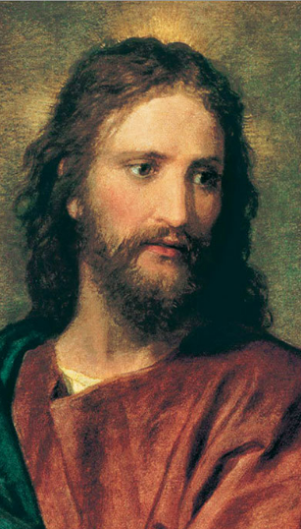
Your Perception of Grace, Christ or Claus

Slide 4
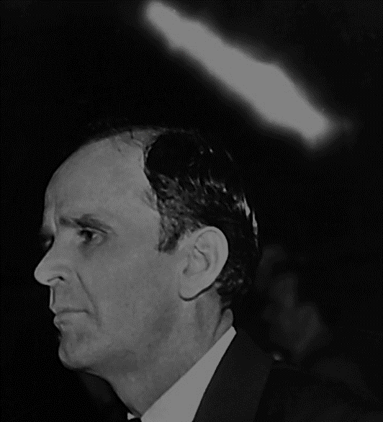
65-1127B Trying To Do God A Service …
When you once see the Message of the hour, there’s nothing else you can see but That. That’s all. Everything else is gone, the rest of it’s just a filler… when you once see the Message!

Slide 5
65-0718E Spiritual Food In Due Season
91 Now, we find out that Elijah could say that, because the Message of the hour and the Word of God, or, the messenger, the Message, and the Word, was exactly the same thing.

Slide 6
65-0718E Spiritual Food In Due Season
The prophet, the Word, the Message; messenger, Message, and Message, was the same. Jesus said, “If I do not the works that’s written of Me, then don’t believe Me.” That’s good. Any man and his message is one.

Slide 7
65-0718E Spiritual Food In Due Season
92 That’s why today that they do not believe in doing the works of God, because they do not accept the Message of God. They don’t believe the Message.

Slide 8
Christ is the Message of the Hour in which you are living.

Slide 9
You CANNOT accept Christ and THEN accept “The Message”.

Slide 10
To accept Christ is to accept the Message of your hour.

Slide 11
Grace is not like God is handing out treats that he made in heaven.

Slide 12
That idea is represented by another person…

Slide 13
… Santa Claus.

Slide 14
Grace is Emmanuel, God with us.

Slide 15
ISAIAH 3 : 8 - 11
. . . To each a reward! . . .

Slide 16
A person cannot accept Christ, then continue to live for sin.

Slide 17
Pleasure of sin is it’s own reward. Christ is the reward of those who believe on Him. Take your pick.

Slide 18
65-0801M The God Of This Evil Age
56 The two spirits. One of them, God’s Holy Spirit; the other one, the devil’s spirit, working in deception. The people of the earth are now making their choice.

Slide 19
65-0801M The God Of This Evil Age
The Holy Spirit is here calling out a Bride for Christ. He is doing it by vindicating His Word of promise to Her, for this age, showing that It is Christ.

Slide 20
ROMANS 6 : 10 - 23
. . . free from . . .

Slide 21
MATTHEW 6 : 22 - 24
. . . None can serve two . . .

Slide 22
I JOHN 4 : 16 - 21
. . . openness in the day of judgement and the liar . . .

Slide 23
What can I do for someone who has rejected Grace?

Slide 24
Their decision is sovereign. YOU cannot change their decision.

Slide 25
BUT YOU CAN … 1.) Speak Truth in Love (plant seed) 2.) Live Godly in a Holy Spirit atmosphere (water) 3.) Pray for Him to soften their heart to The Message.

Slide 26
Your Perception of Grace, Christ or Claus

